Slide 1
Chapter 1.1 Introduction to Software Construction
CCSW 325 (Software Construction)
Notes:
Last Update: 22/8/2019
Version 1.0

Slide 2
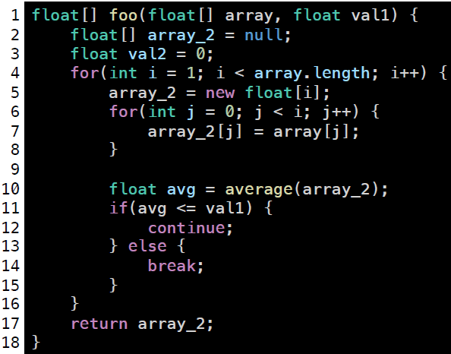

Clean Code
What does this function do?
What is wrong?
A Better version?

Slide 3
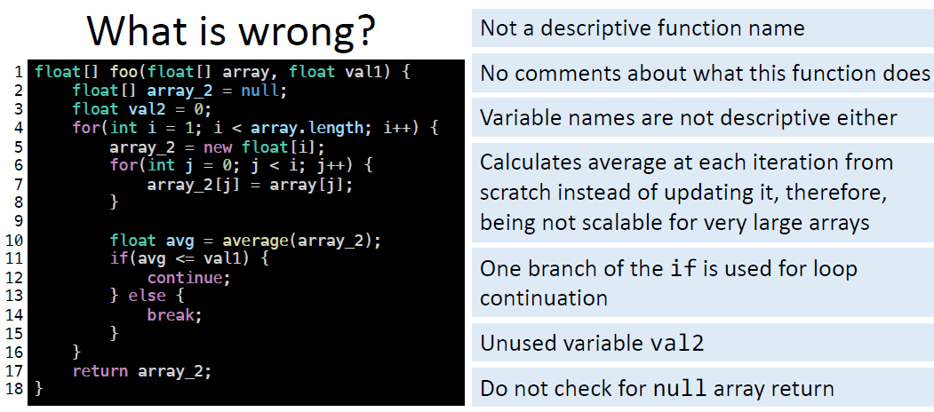
Clean Code

Slide 4
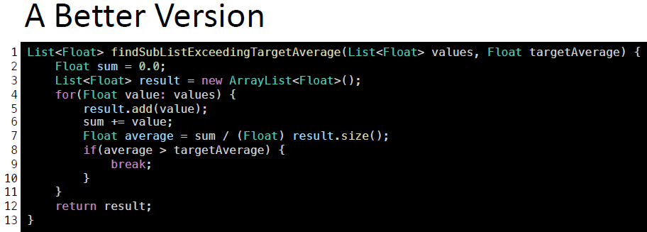
Clean Code
.

Slide 5
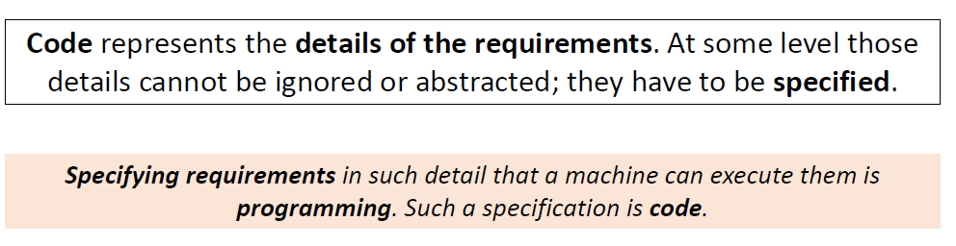

Clean Code

Slide 6
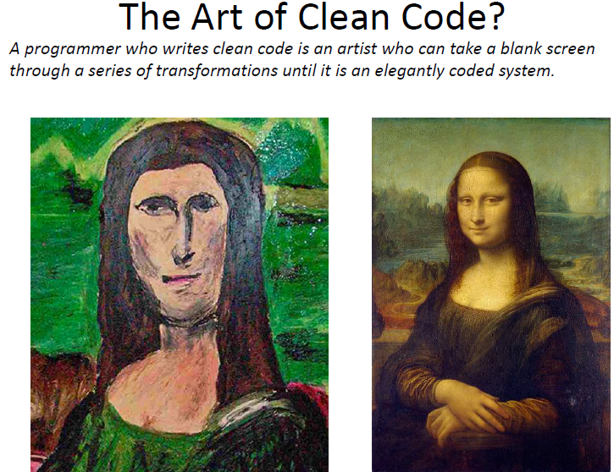
Clean Code

Slide 7
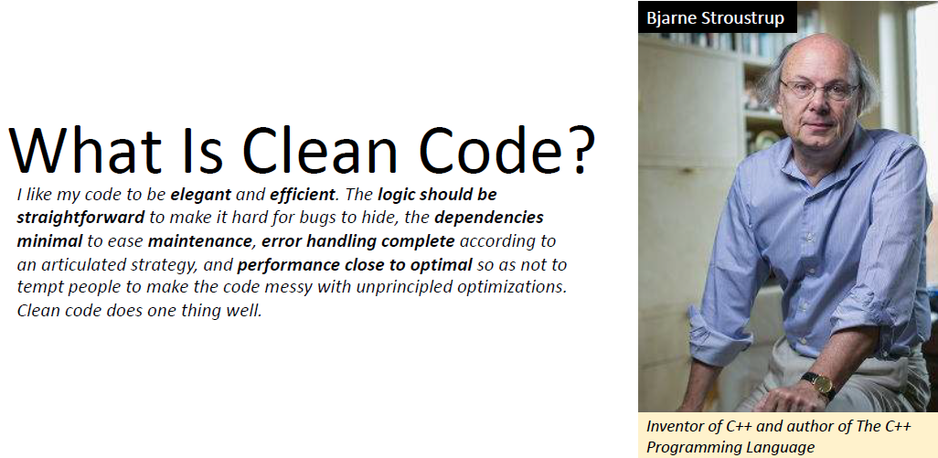
Clean Code

Slide 8
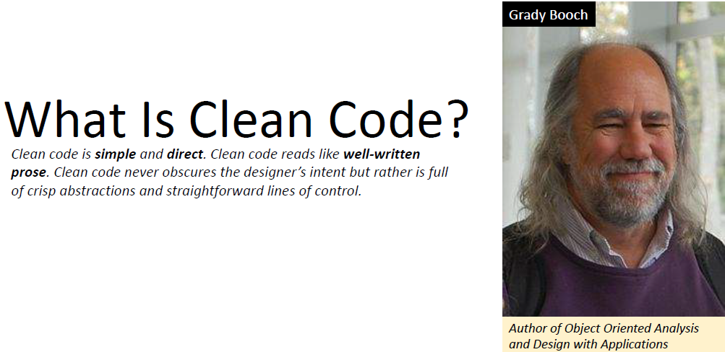
Clean Code

Slide 9
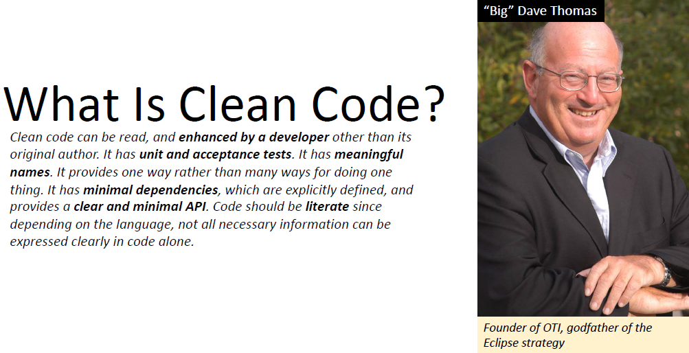
Clean Code

Slide 10
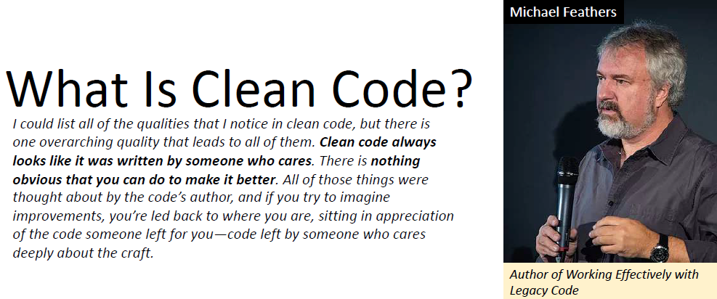
Clean Code

Slide 11
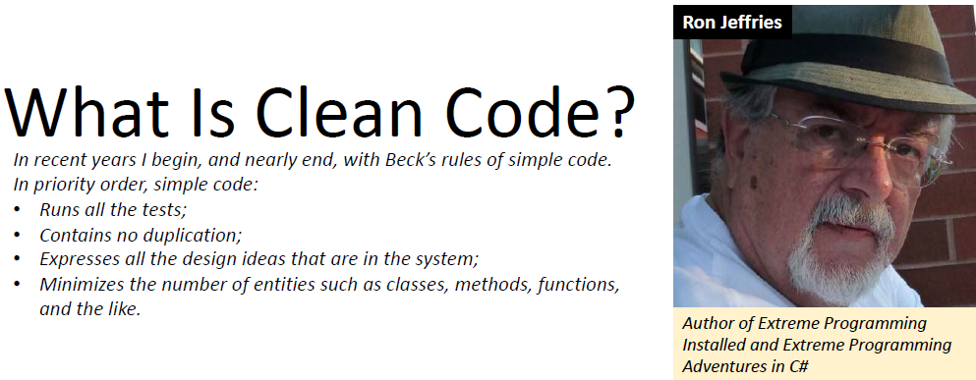
Clean Code

Slide 12
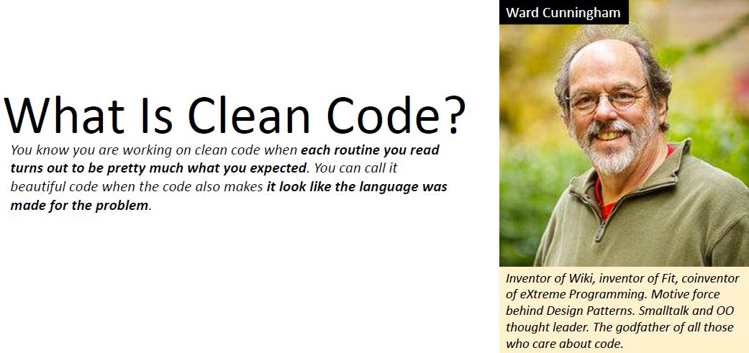
Clean Code

Slide 13
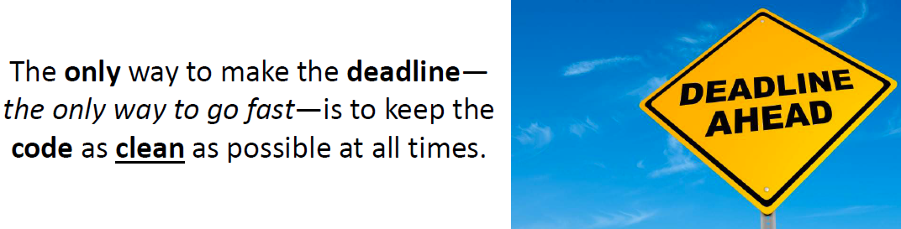
Clean Code

Slide 14

Clean Code

Slide 15
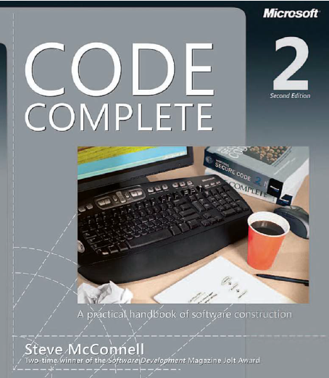
Reading
Code Complete: A Practical Handbook of Software Construction, 2nd Edition, Steve McConnell.
Chapter 1

Slide 16

Any questions? ​
Please feel free to raise your hands and ask.

